Slide 1
Inclusive Volunteering
Turning intent into action
Janice Malone (she/her)

Slide 2
Data and evidence
Who volunteers?
In Scotland
Employed / in education
Live in less
deprived areas
Higher income
Live in rural areas
Female
Scottish Household Survey 2019 data

Slide 3
Data and evidence
“There is clear-cut evidence that those subject to exclusion and disadvantage in society have the most to gain from volunteering”.
People with mental and physical health conditions
Those subject to social isolation and loneliness
Unemployed people
Asylum seekers & refugees
Armed forces veterans
Volunteering, Health and Wellbeing - What does the evidence tell us?
Volunteer Scotland 2018

Slide 4
Volunteering Together: Inclusive Volunteering and Disabled People
‘The findings show that disabled people volunteer just as much as non-disabled people and they tend to volunteer more frequently and for longer.’
Estimated 3.6 million disabled volunteers in the UK…
…giving an average of 12 hours per month
Spirit of 2012 report (May 2022)

Slide 5
Volunteering Together: Inclusive Volunteering and Disabled People
Conclusions and ideas for action:
Improve understanding of how the social model of disability can be implemented in practice
Take an asset-based approach to volunteering by focusing on the value and contribution the of the volunteer and the lived experience they bring to the role.
Provide flexible volunteering opportunities
Pay attention to the culture in your organisation and the attitudes of staff and volunteers
Link EDI and volunteer strategies together
Build trusted and supportive relationships
Acknowledge that people have intersecting identities
Spirit of 2012 report (May 2022)
Notes:
Conclusions and ideas for action
22 directed at staff working in volunteer management
Further 11 directed at policy makers
Highlight just a few here today:
1. Improve understanding of how the social model of disability can be implemented in practice – it’s not about the impairment, it’s about meeting needs and removing barriers
2. Provide flexible volunteering opportunities that can adapt to people’s changing circumstances and encourage movement between different roles and activities within your organisation
3. Link EDI and volunteer strategies together and make sure that these strategies reflect the ethos and values of your organisation
4. Take an asset-based approach to volunteering by focusing on the value and contribution the volunteer and the lived experience they bring to the role.
5. Pay attention to the culture in your organisation and the attitudes of staff and volunteers – look out for stereotypes, stigma and unconscious bias about disabled people and ensure all volunteers feel welcomed and valued.
Build trusted and supportive relationships and create spaces where people feel safe to talk about their needs.
Acknowledge that people have intersecting identities – disability is not one dimensional and not everyone with support and access needs will identify as a disabled person
Get buy-in and commitment from leadership and senior staff members
Include volunteer expenses when applying for funding.
Ensure remote and online volunteering opportunities are accessible and well supported including for those who may lack confidence and digital skills.
Make it easy and normal for volunteers to get reimbursed for things like transport costs.
Consider how digital processes may increase barriers to the involvement of people who are not online and impact on how information is shared within your organisation
Use a range of recruitment methods and consider reaching out to disabled people through disability or user-led organisations and groups.
Look out for partnership working opportunities that may lead to additional capacity and resources.
Develop or access disability inclusive training for staff and volunteers in your organisation.

Slide 6
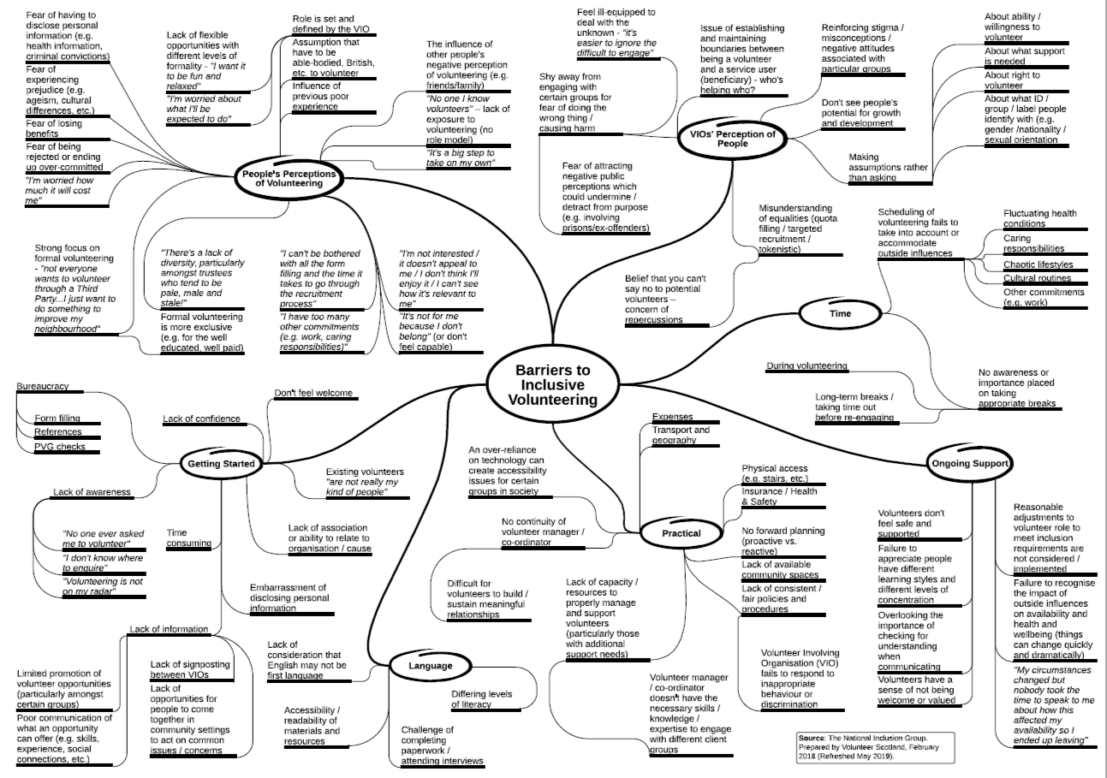
Data and evidence / current state

Slide 7
Volunteering For All: National Outcomes Framework
Five outcome areas:
Policy impact
Lifelong engagement
Places and space
Recognition and celebration
Inclusive volunteering

Slide 8
Volunteering Action Plan: Inclusive volunteering working group
24 individuals with a commitment to improving the inclusivity of volunteering in Scotland
Scope
Evidence
Mapping
Themes
Actions
National Inclusion Group

Slide 9
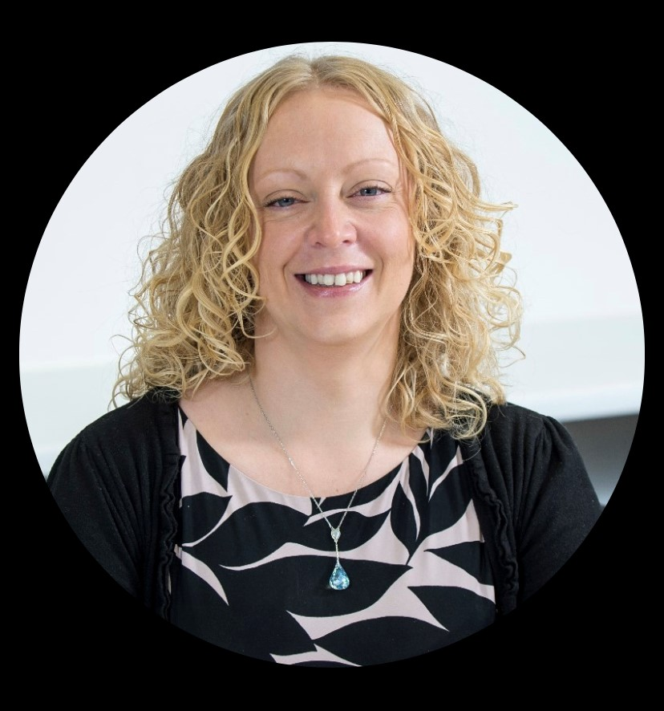
A year of learning
Solutions not barriers
Person centred
Power
Professional diversity

Slide 10
Turn your good intentions into action
Processes
Small steps
Personal reflection
Connect

