Slide 1


Interconnected Systems Mapping: Session One
Supporting better quality health and social care for everyone in Scotland
Notes:
Before starting the ISM workshop, it is useful holding an ice breaker activity. With ISM it is useful to ask people to take ID badges off, in order to facilitate across a group with no fixed ideas about each other.
Ice Breakers might be- find someone who (people bingo), or hopes and expectations in pairs that swap every 3 mins,
Following this slide, you may want a brief overview of the locality, or stats about the system you are going to be mapping- please include your own alternative title and layout slides

Slide 2
Agenda
Time | Title
15mins | Welcome and Introduction
15mins | Purpose of an Interconnected System Map (ISM)
30mins | Developing the ISM: Part One
15mins | Comfort Break
45mins | Developing the ISM: Part Two
 | Next Steps and Close
Notes:
This slide is simply an overview of what is included in the presentation about ISM.
An activity at this point may be to ask people to work in pairs or small groups and define Interconnected; System; and Map. This will help people to focus on what is and isn’t expected of them and is and isn’t possible within the workshop. It could also be helpful to have a hopes and fears flipchart up and ask for feedback about that, in order to refer to it throughout the session.

Slide 3
Purpose of an ISM
To deliver a visual overview of an integrated health, social care and community system
Once completed, can be considered for what insights it offers around the interconnectedness of the system.
Help provide an understanding of the flow of demand on the health and social care system, indicate focus areas for further improvement work, and enable informed strategic decision-making.
Notes:
An ISM can help in visualising, understanding and discussing any system. As we are so often only involved in one part of a system, it is important when creating opportunities for change to see the whole system and how the interactions at different parts of the system work or could be improved. Many of us will have been involved in work to look at patient flow, but understanding this in the context of the whole system can bring a new perspective and deepen our understanding.

Slide 4
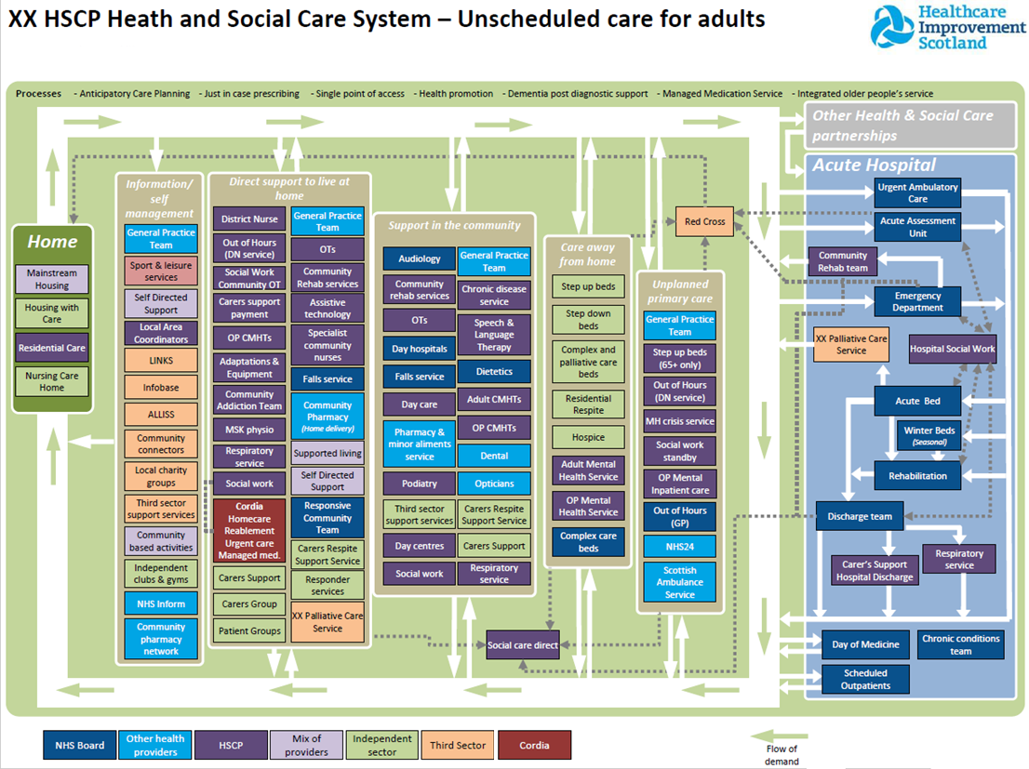
Example ISM
Notes:
First thing to say is Please don’t feel overwhelmed! Although this is a very highly technical and well laid out example of an ISM they do not have to be like this to be effective and useful for the purposes outlined in the previous slide. What is important about this is that it is focused on a clear system (unscheduled care for adults in a HSCP), that it looks at the key components of this system, at various levels- eg primary care, secondary care, bed days, acute hospital, and looks at flow through this system.

Slide 5
What an ISM Can Do
Identify areas for focus
Make a complex system visible
Highlight gaps between ‘as is’ and ‘to be’
Inform decision-making for change
Avoid unintended consequences
Identify which services may be affected by a change
Build shared understanding of the system and connections
Identify stakeholders
People can see their role within a wider system of support
Notes:
With the clarity about the purpose of an ISM and bringing to light people’s hopes and fears for the session, and then showing the example of the ISM when finished. This slide builds on this by outlining what an ISM can do, what it is specifically going to be able to deliver to help create opportunities for change, reflection and increased knowledge by and within the system.
It is a sense making tool in that it allows everyone involved to see the whole system and not just the part they are involved in. it allows people to understand the flow and the experience of people as things are within the system as it is set up currently.
As it is a visualisation for a whole system, an ISM can enable decisions about change to be made with a full understanding about the system impact. And the benefits to different parts of the system.
It also therefore can enable discussion about what needs to change in order to overcome challenges or to create better pathways through the system.
Both the sessions that develop the ISM, and the ISM itself bring together a range of stakeholders. This is positive development within any system. This opportunity to bring stakeholders from across different parts of the same system to be together, to understand better the whole system they are part of and to have conversatons about the system they sit within is a powerful mechanism to vreating change and developing networks.

Slide 6
What an ISM Doesn’t Do
Provide the answer!
Make recommendations, forecasts or predictions
Provide insights in to context, culture, behaviours, experiences
Show the reasons behind failure demand
Show / monitor user flow, access or uptake of services
Notes:
As with all maps, seeing the map doesn’t tell anyone how it has been used, how to navigate it, or what exists within any part of it.
An ISM doesn’t describe for example delayed discharges, or blocks for people within the system. An ISM doesn’t give an answer about what to do about challenges within the system. It is a way of visualising the system, and seeing the whole system. But only using this to then discuss issues about flow, referral and patient pathways, and culture about the system can change and development occur. It is easy to get caught up with these discussions while undertaking an ISM. It is more helpful to have this conversation when the whole system is visualised. It is at this point that the next stage of analytical work can begin.

Slide 7
Developing an ISM
What we’ll work through today
  Each of the headings
  Information to note for each service:
    Access (direct access, referral)
    Who provides it
    Scheduled/Unscheduled
Expectations of everyone today
  Focus on how things are, not how they should be
  Question / challenge
Notes:
At this point, all the information about the reach and limitations of an ISM has been given. The session has got a clear aim and is now focused on developing the ISM itself. The groundrules outlined above all to help everyone participate and to ask people o understand that it is their contribution to this process which will make a difference to the ISM being as rich as possible.
For each of the headings within the ISM break people into small groups and give them time- 20 to 30 minutes, to outline everything they feel belongs in that part of the system map. There will be services and teams who appear across multiple parts of the map. That is fine. The idea of the session is to create a map which represents how the system works currently.

Slide 8

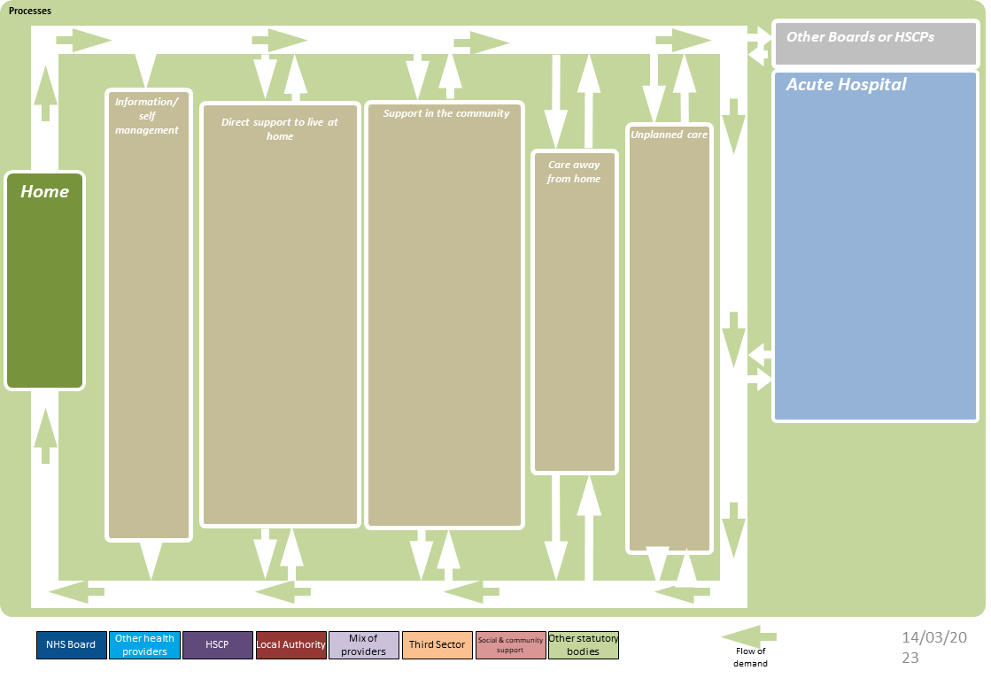
Heath and Social Care System – xxxxx
Created by Strategic Planning Portfolio, ihub, Healthcare Improvement Scotland.
Notes:
Each group will need-
Flip chart paper
Post it notes
Pens
Around 20 to 30 minutes for each section of the ISM
For each of the relevant headings (not every ISM will have exactly the same headings, and they may need to be localised to suit the purpose of the ISM) ask people in groups to discuss and note on post it notes every thing/ service/ team that operates at that point of the system. This may be community, or acute, or self referral, and so on. It is helpful to start with the parts of the map on the left of the ISM- information and self management, and work through to acute or unscheduled care. There will be services and teams that appear at multiple parts of the map. That is fine. The map should include both statutory and non public sector services.

Slide 9
Definitions of Care Settings
Care setting | Definition
Information/Support for self management | Information or service that provides people with what they need to manage their situation without formal services
Direct support to live at home | Services that provide care or support in the person’s home
Support in the community | Services that people are required to attend, away from their home, in order to be cared for
Care away from home | Care that involves staying overnight away from the persons’ home
Unplanned care | Care services that are accessed in an emergency
Acute hospital | Services that are accessed within a hospital
Notes:
At this point, all the information about the reach and limitations of an ISM has been given. The session has got a clear aim and is now focused on developing the ISM itself. The groundrules outlined above all to help everyone participate and to ask people o understand that it is their contribution to this process which will make a difference to the ISM being as rich as possible.
For each of the headings within the ISM break people into small groups and give them time- 20 to 30 minutes, to outline everything they feel belongs in that part of the system map. There will be services and teams who appear across multiple parts of the map. That is fine. The idea of the session is to create a map which represents how the system works currently.

Slide 10
Session Two
We will reflect back the data and information from today
Discuss the connections between services
Highlight additional access criteria
Discuss initial reflections
Notes:
At this point, all the information about the reach and limitations of an ISM has been given. The session has got a clear aim and is now focused on developing the ISM itself. The groundrules outlined above all to help everyone participate and to ask people o understand that it is their contribution to this process which will make a difference to the ISM being as rich as possible.
For each of the headings within the ISM break people into small groups and give them time- 20 to 30 minutes, to outline everything they feel belongs in that part of the system map. There will be services and teams who appear across multiple parts of the map. That is fine. The idea of the session is to create a map which represents how the system works currently.

Slide 11
Keep in touch
Twitter: @online_his
Email: comments.his@nhs.scot
Web: healthcareimprovementscotland.org
Blog: blog.healthcareimprovementscotland.org
Supporting better quality health and social care for everyone in Scotland
Notes:
Please do encourage anyone who would like to know more or to be in touch about a specific issue to contact the ihub team. We are very friendly!

