Slide 1

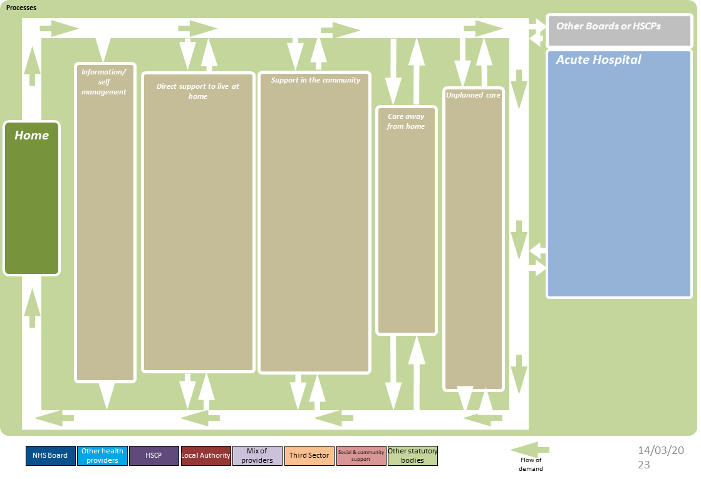
Heath and Social Care System – xxxxx
Created by Strategic Planning Portfolio, ihub, Healthcare Improvement Scotland.
Notes:
Each group will need-
Flip chart paper
Post it notes
Pens
Around 20 to 30 minutes for each section of the ISM
For each of the relevant headings (not every ISM will have exactly the same headings, and they may need to be localised to suit the purpose of the ISM) ask people in groups to discuss and note on post it notes every thing/ service/ team that operates at that point of the system. This may be community, or acute, or self referral, and so on. It is helpful to start with the parts of the map on the left of the ISM- information and self management, and work through to acute or unscheduled care. There will be services and teams that appear at multiple parts of the map. That is fine. The map should include both statutory and non public sector services.

