Slide 1
Using Three Horizons in your planning
Graphics for your use
June 2025

Slide 2
******
Want to use Three Horizons with your stakeholders? Here you can find the graphics we used that you could integrate into your presentations and workshops.
Please note that most of the graphics are drawn from the Public Health Wales paper on Three Horizons.

Slide 3
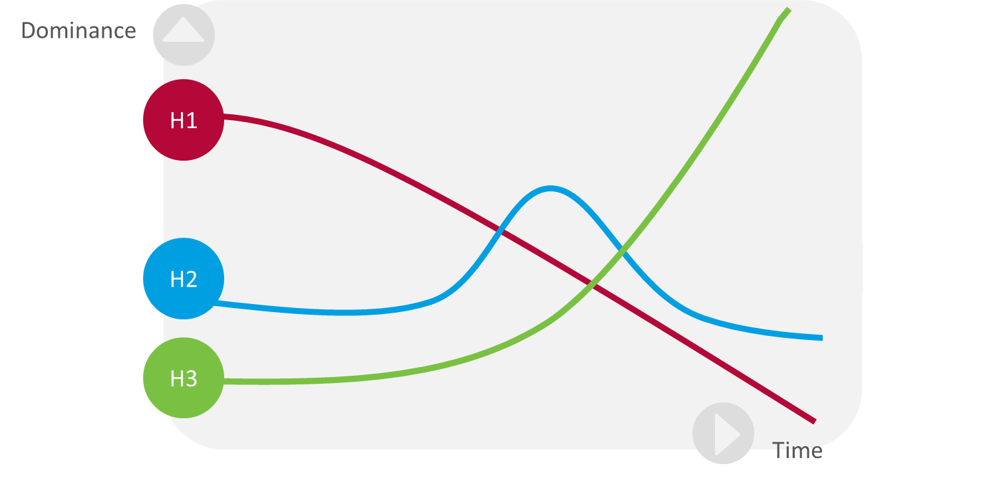

Slide 4
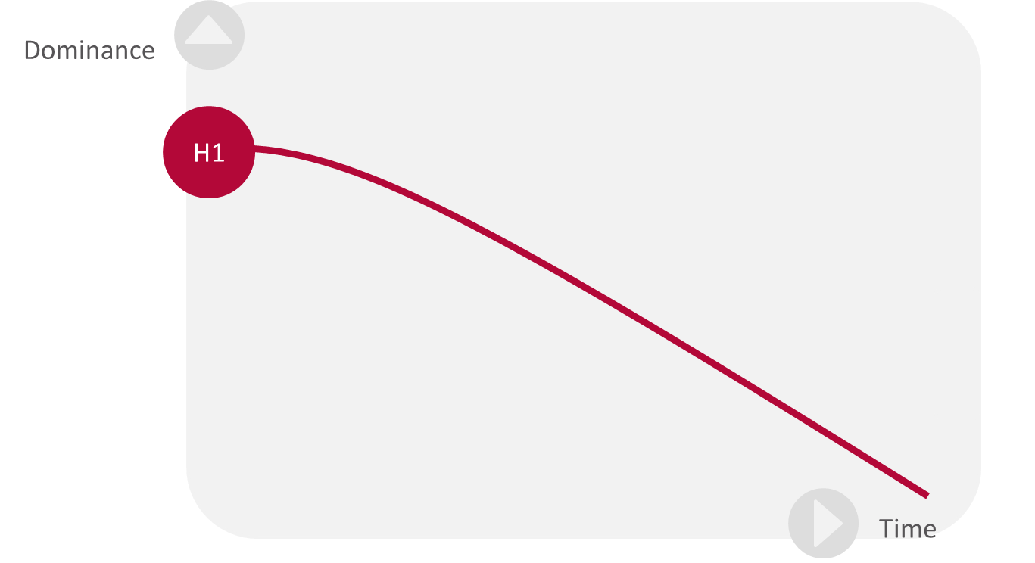

Slide 5
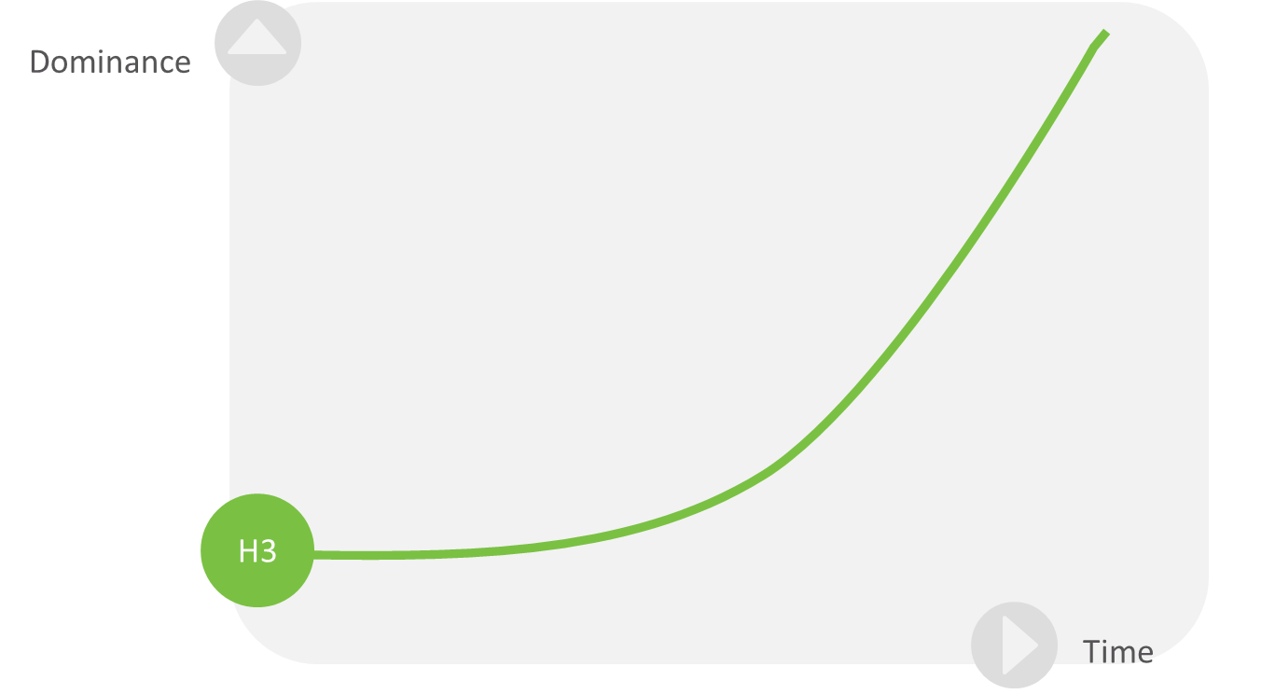

Slide 6
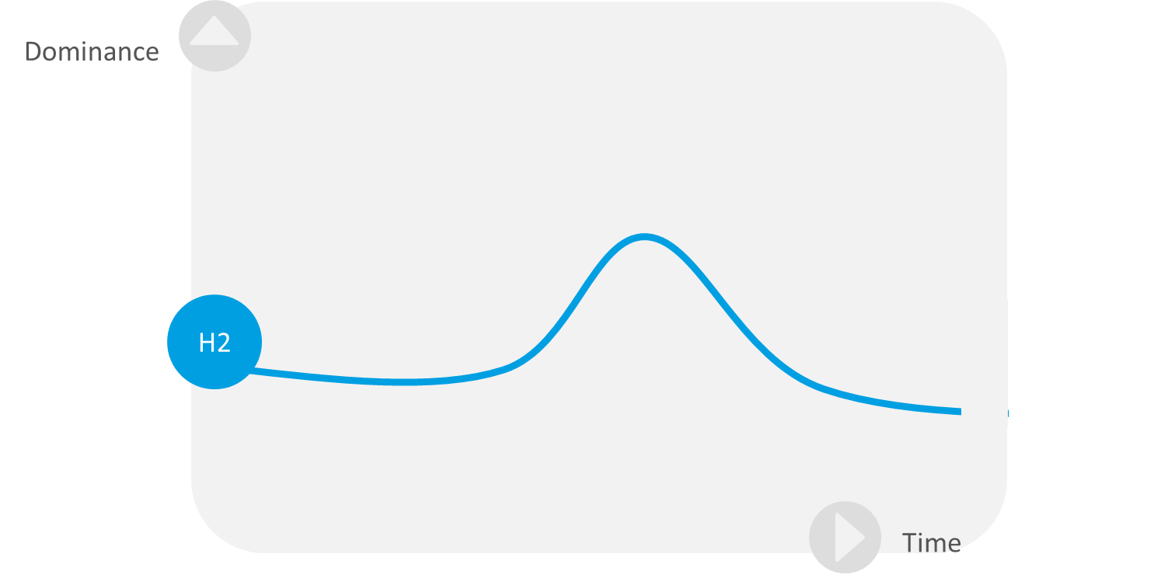
6

Slide 7
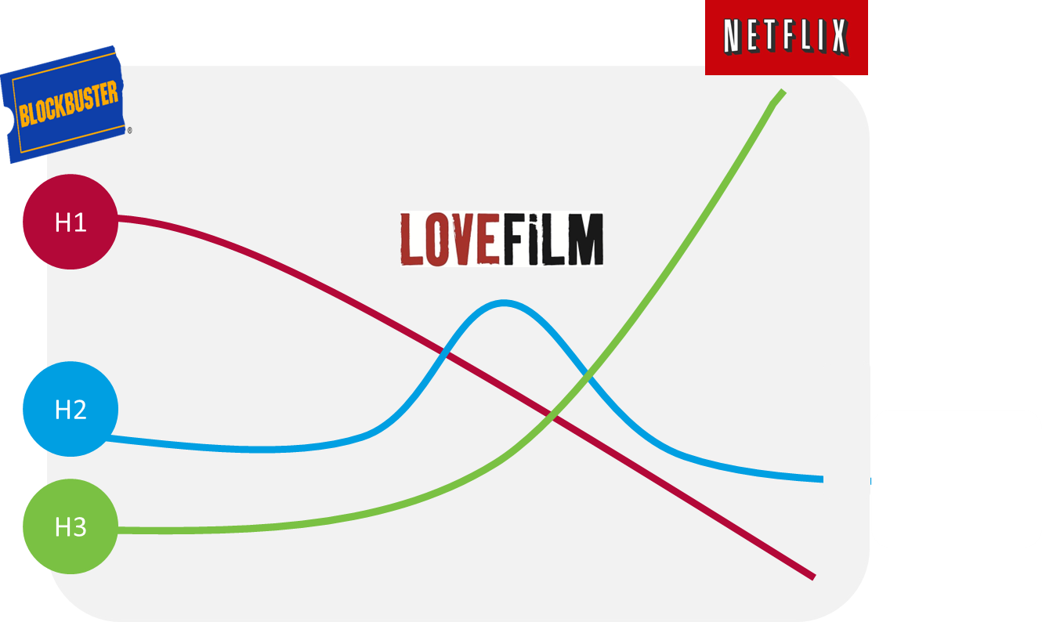

Slide 8
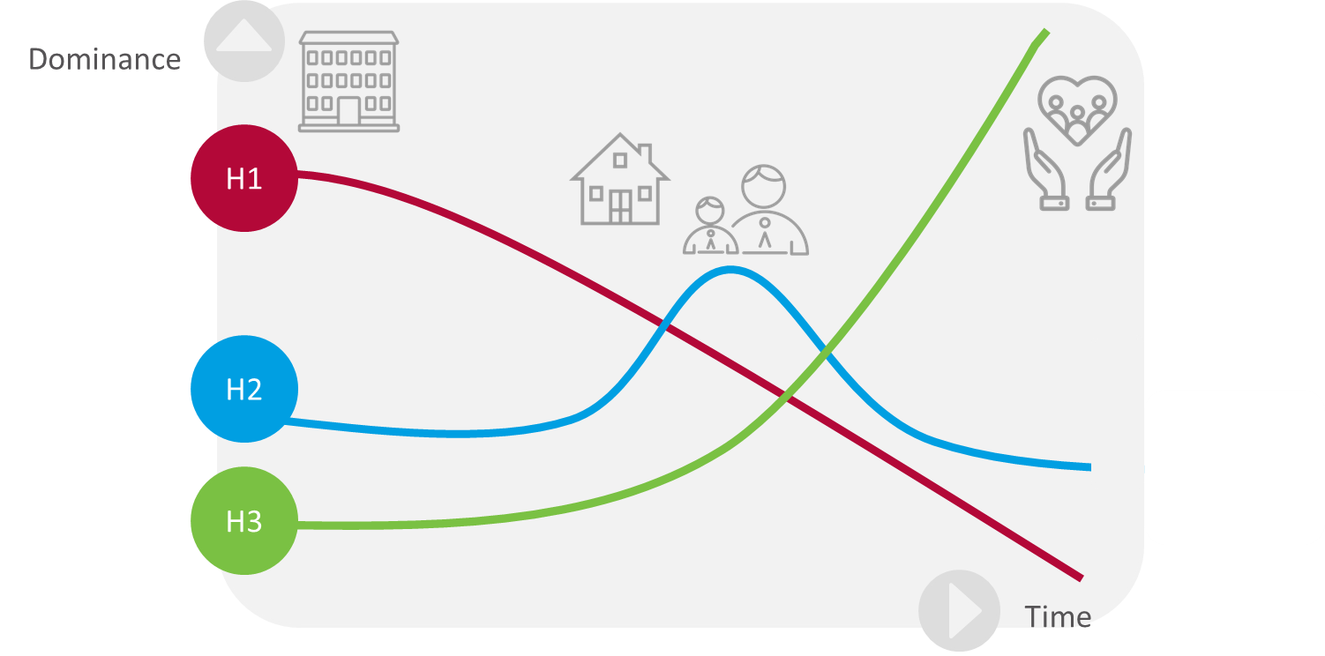

Slide 10
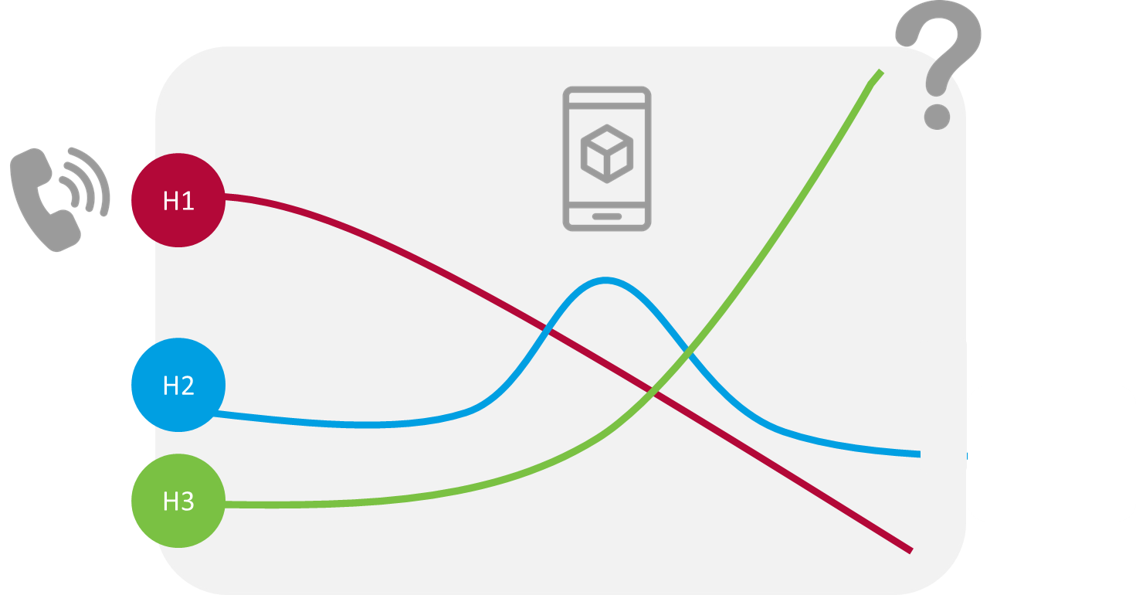

Slide 11
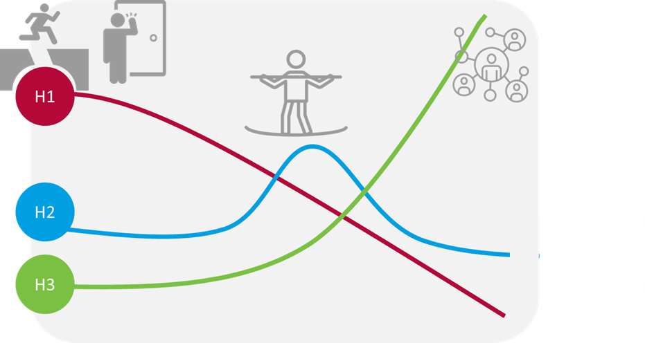

Slide 12
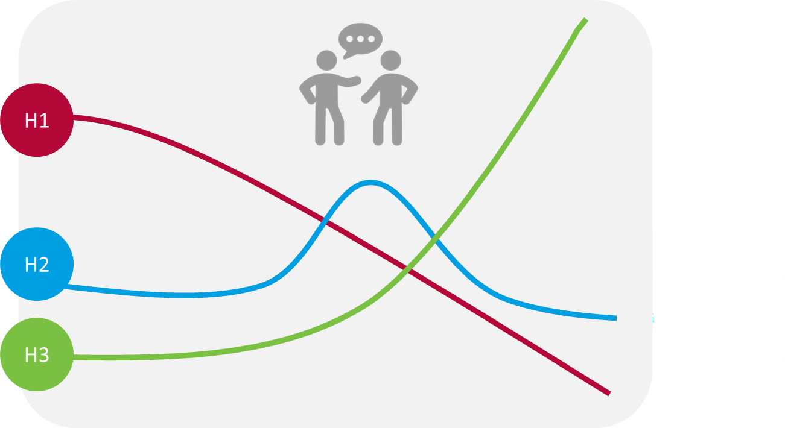

Slide 13
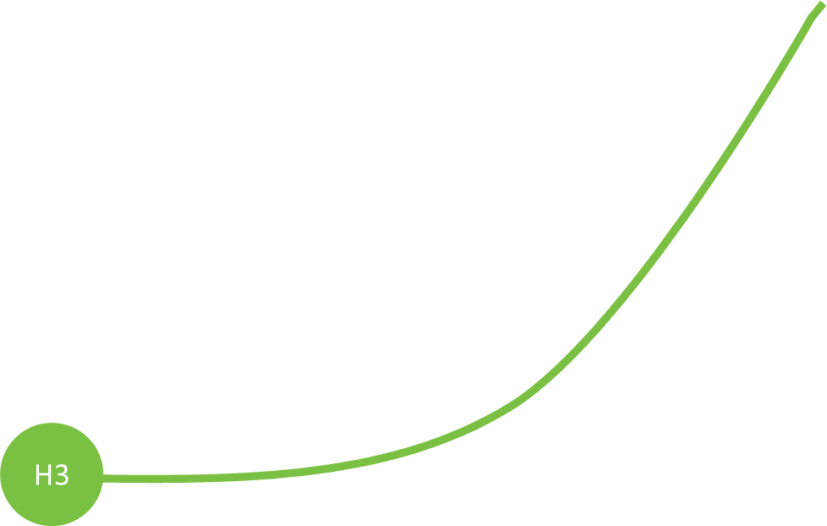
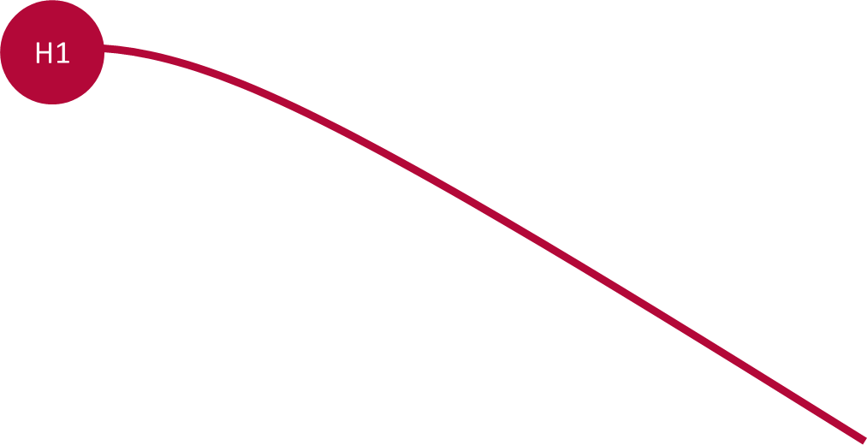

Slide 16
Healthcare Improvement Scotland
June 2025
This document is licensed under the Creative Commons Attribution-Noncommercial-NoDerivatives 4.0 International Licence. This allows for the copy and redistribution of this document as long as Healthcare Improvement Scotland is fully acknowledged and given credit. The material must not be remixed, transformed or built upon in any way. To view a copy of this licence, visit https://creativecommons.org/licenses/by-nc-nd/4.0/
We are happy to consider requests for other languages or formats. Please contact our Equality and Diversity Advisor on 0141 225 6999 or email his.contactpublicinvolvement@nhs.scot
www.healthcareimprovementscotland.org

